Slide 1
Kentucky Lead Workgroup
Findings and Best Practices
KWWOA Annual Conference
Northern Kentucky Convention Center
April 9, 2018
Peter Goodmann
Kentucky Division of Water

Slide 2
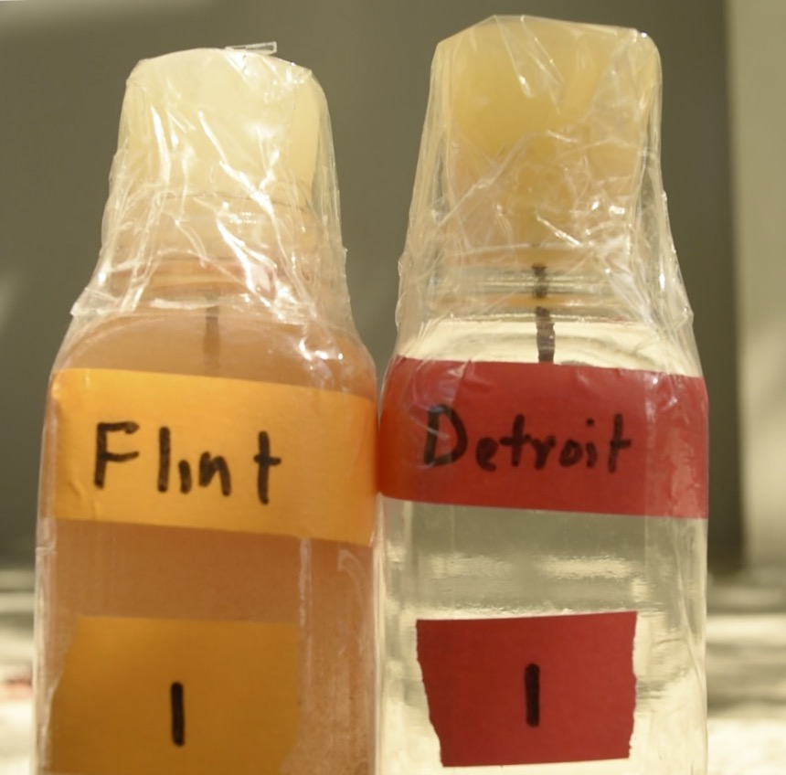
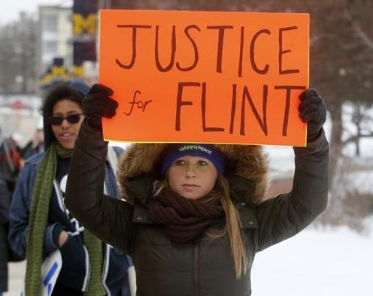
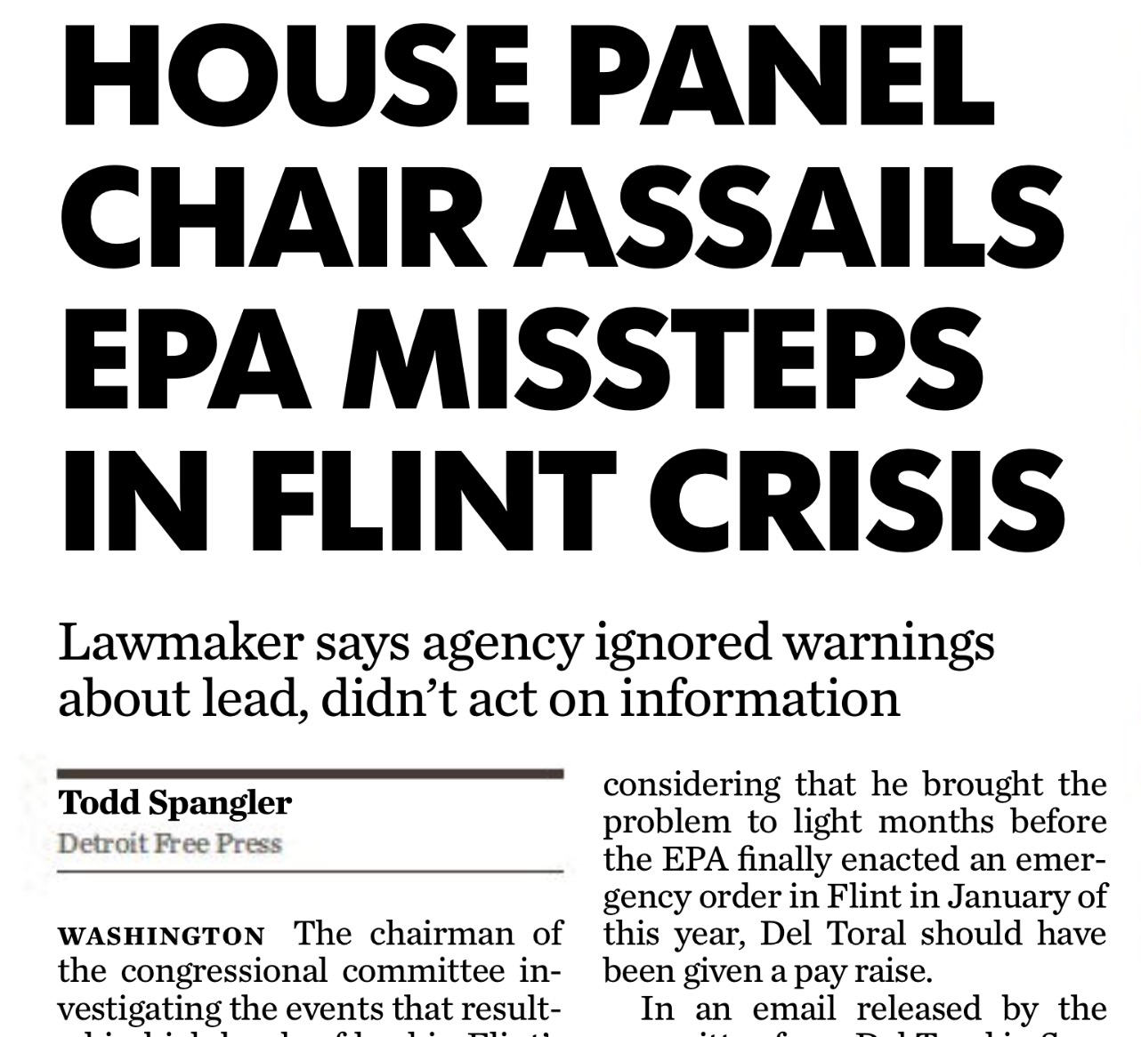
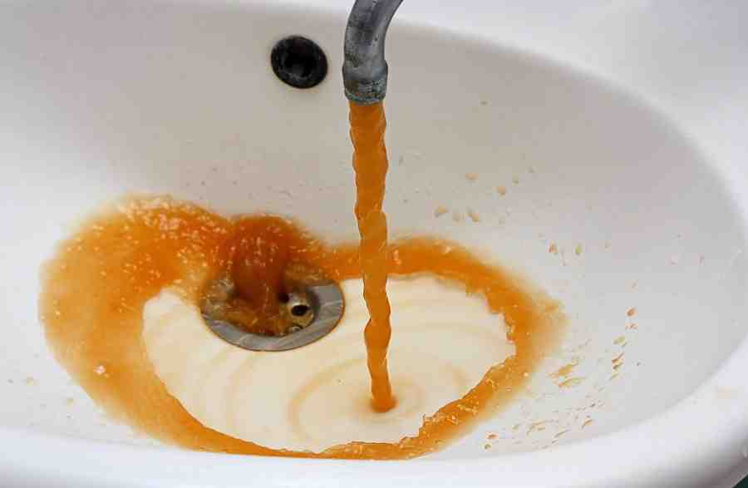
Flint Public Health Crisis

Slide 3
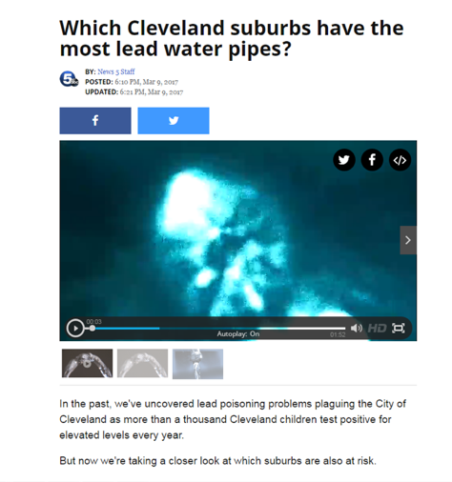
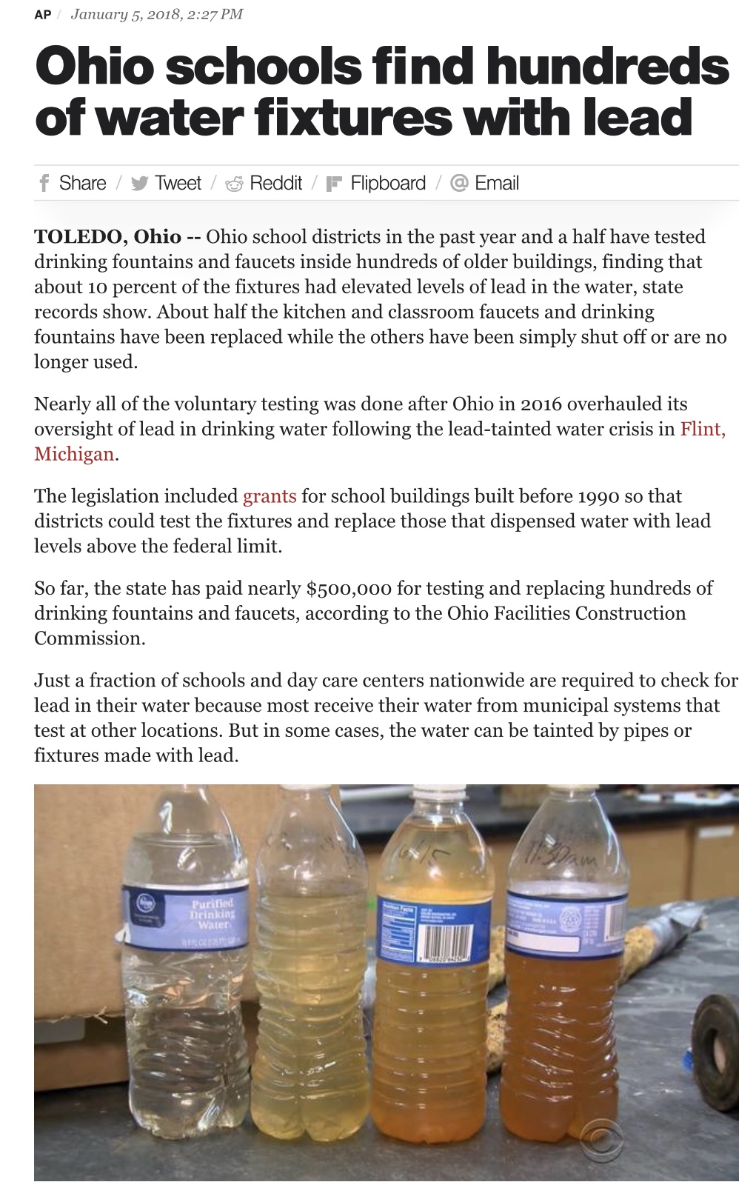
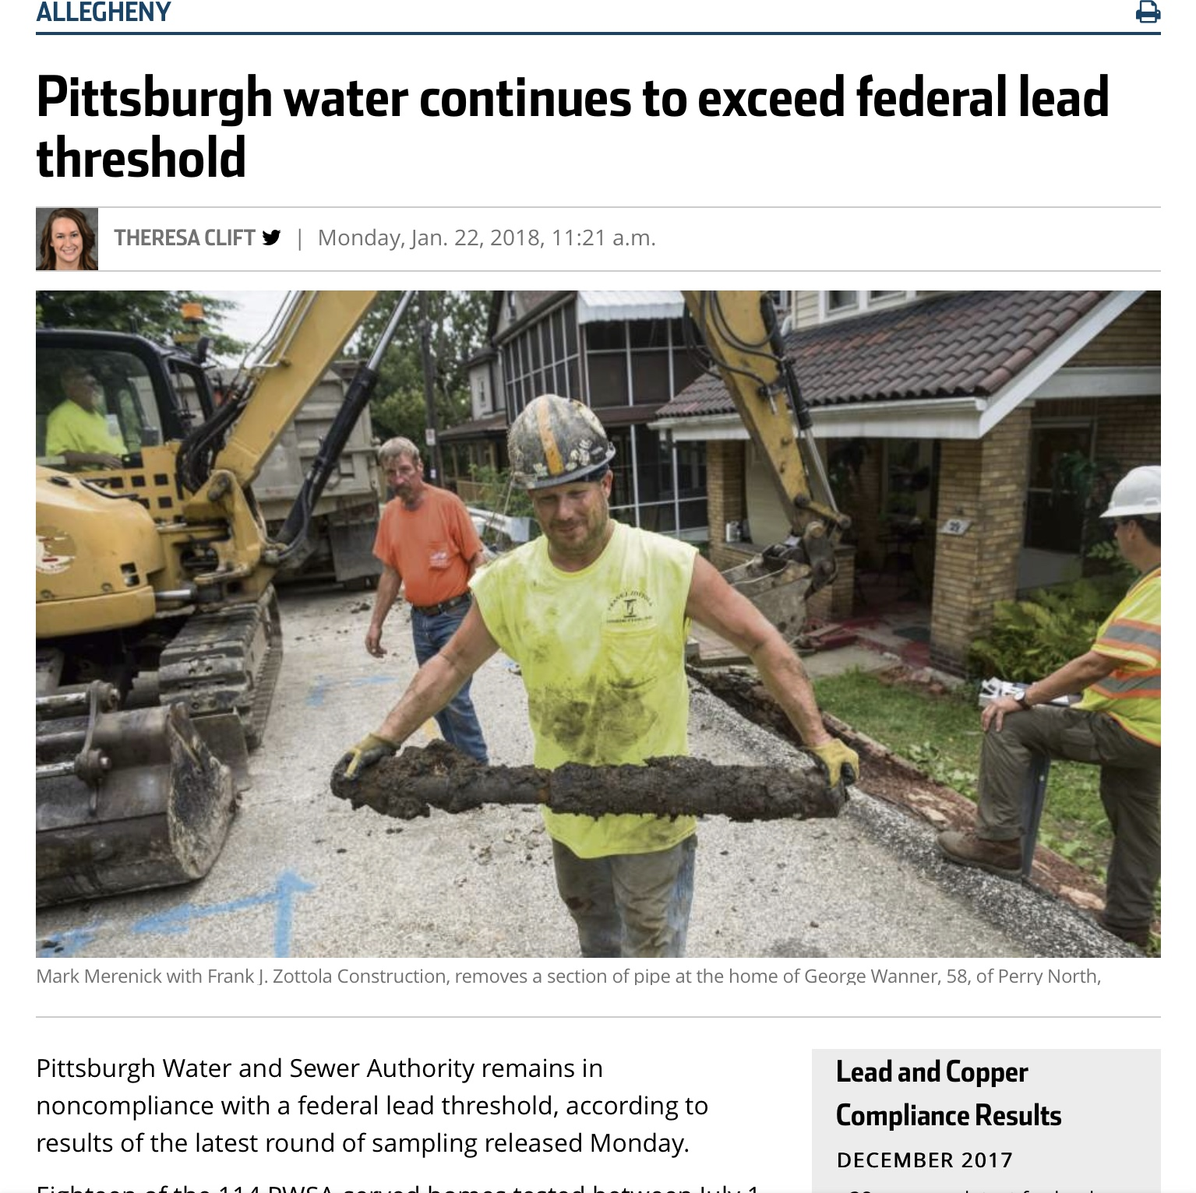
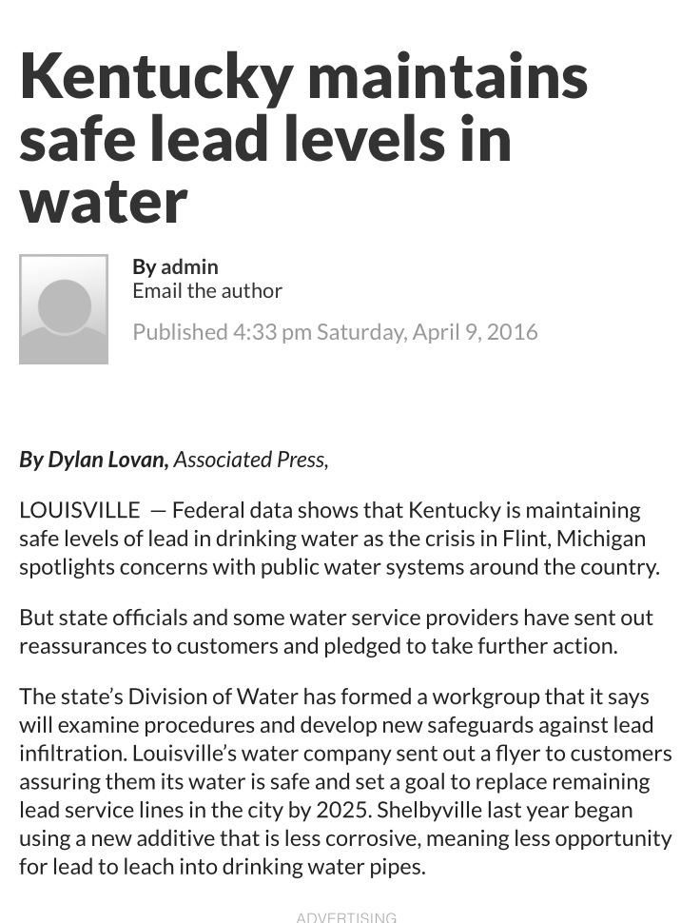
Trouble Spreading

Slide 4
Kentucky Lead Workgroup Members
Jennifer Burt, Kentucky Health Department
Obe Cox, Carroll County Water District
Tom Gabbard, Kentucky Division of Water
Mike Gardner, Bowling Green Municipal Utilities
Greg Heitzman, BlueWater Kentucky
Ron Lovan, Northern Kentucky Water District
Brad Montgomery, GRW Engineers
Bill Robertson, Paducah Water
Tom Rockaway, PhD, University of Louisville
Justin Sensabaugh, Kentucky American Water Company
Rengao Song, PhD, Louisville Water Company
Brian Thomas, Marion Water Department

Slide 5
Kentucky Lead Workgroup
Resources
Peter Goodmann, KY Division of Water
Claude Carothers, KY Division of Water
Samantha Kaiser, KY Division of Water
Susan Lancho, Kentucky American Water
Gary Larimore, Kentucky Rural Water
Kay Sanborn, KY-TN AWWA
Kelley Dearing Smith, Louisville Water Company
Victoria Wilhoite, KY Division of Compliance Assistance

Slide 6
Kentucky Lead Workgroup
First meeting held April 20, 2016
Workgroup generally meets monthly on third Wednesday
Meetings open to the public
Sub-teams established in the following areas:
  Public health
  Lead regulations and compliance record with LCR
  Treatment/Corrosion control
  Distribution/Piping/Plumbing infrastructure
  Training/Education
  Financing/Funding lead replacement
  Communications/Education

Slide 7
Kentucky Lead Workgroup
Expect Final Report to be completed by Sumer, 2018
Deliverables:
  Recommendations
  Power point presentations on each topic area
  Workgroup, compiled by sub-team/topic area
Workgroup report will provide the following:
  Summary of Kentucky’s compliance with EPA’s Lead and Copper Rule
  Best practices for treatment of lead in drinking water
  Best practices for removal of lead pipes, fixtures, etc.
  Preparation for future regulatory changes (lower action levels)
  Best practices for sharing lead information and educating consumers
  Financing practices to fund replacement programs
  Recommendations to State Agencies, Utilities, and Industry Associations

Slide 8

KY Lead Compliance Results
436 Public Water Supply Systems (PWS) in KY
390 PWS monitor for lead under the LCR
# of samples based on population
36,270 Lead Compliance samples 2005-17
75% of samples had no detection (< 2 ppb)
98% of samples less than 15 ppb
3 systems (2%) exceeded 15 ppb
3 systems (<1%) required additional action
Since 2012, all KY PWS comply with LCR

Slide 9
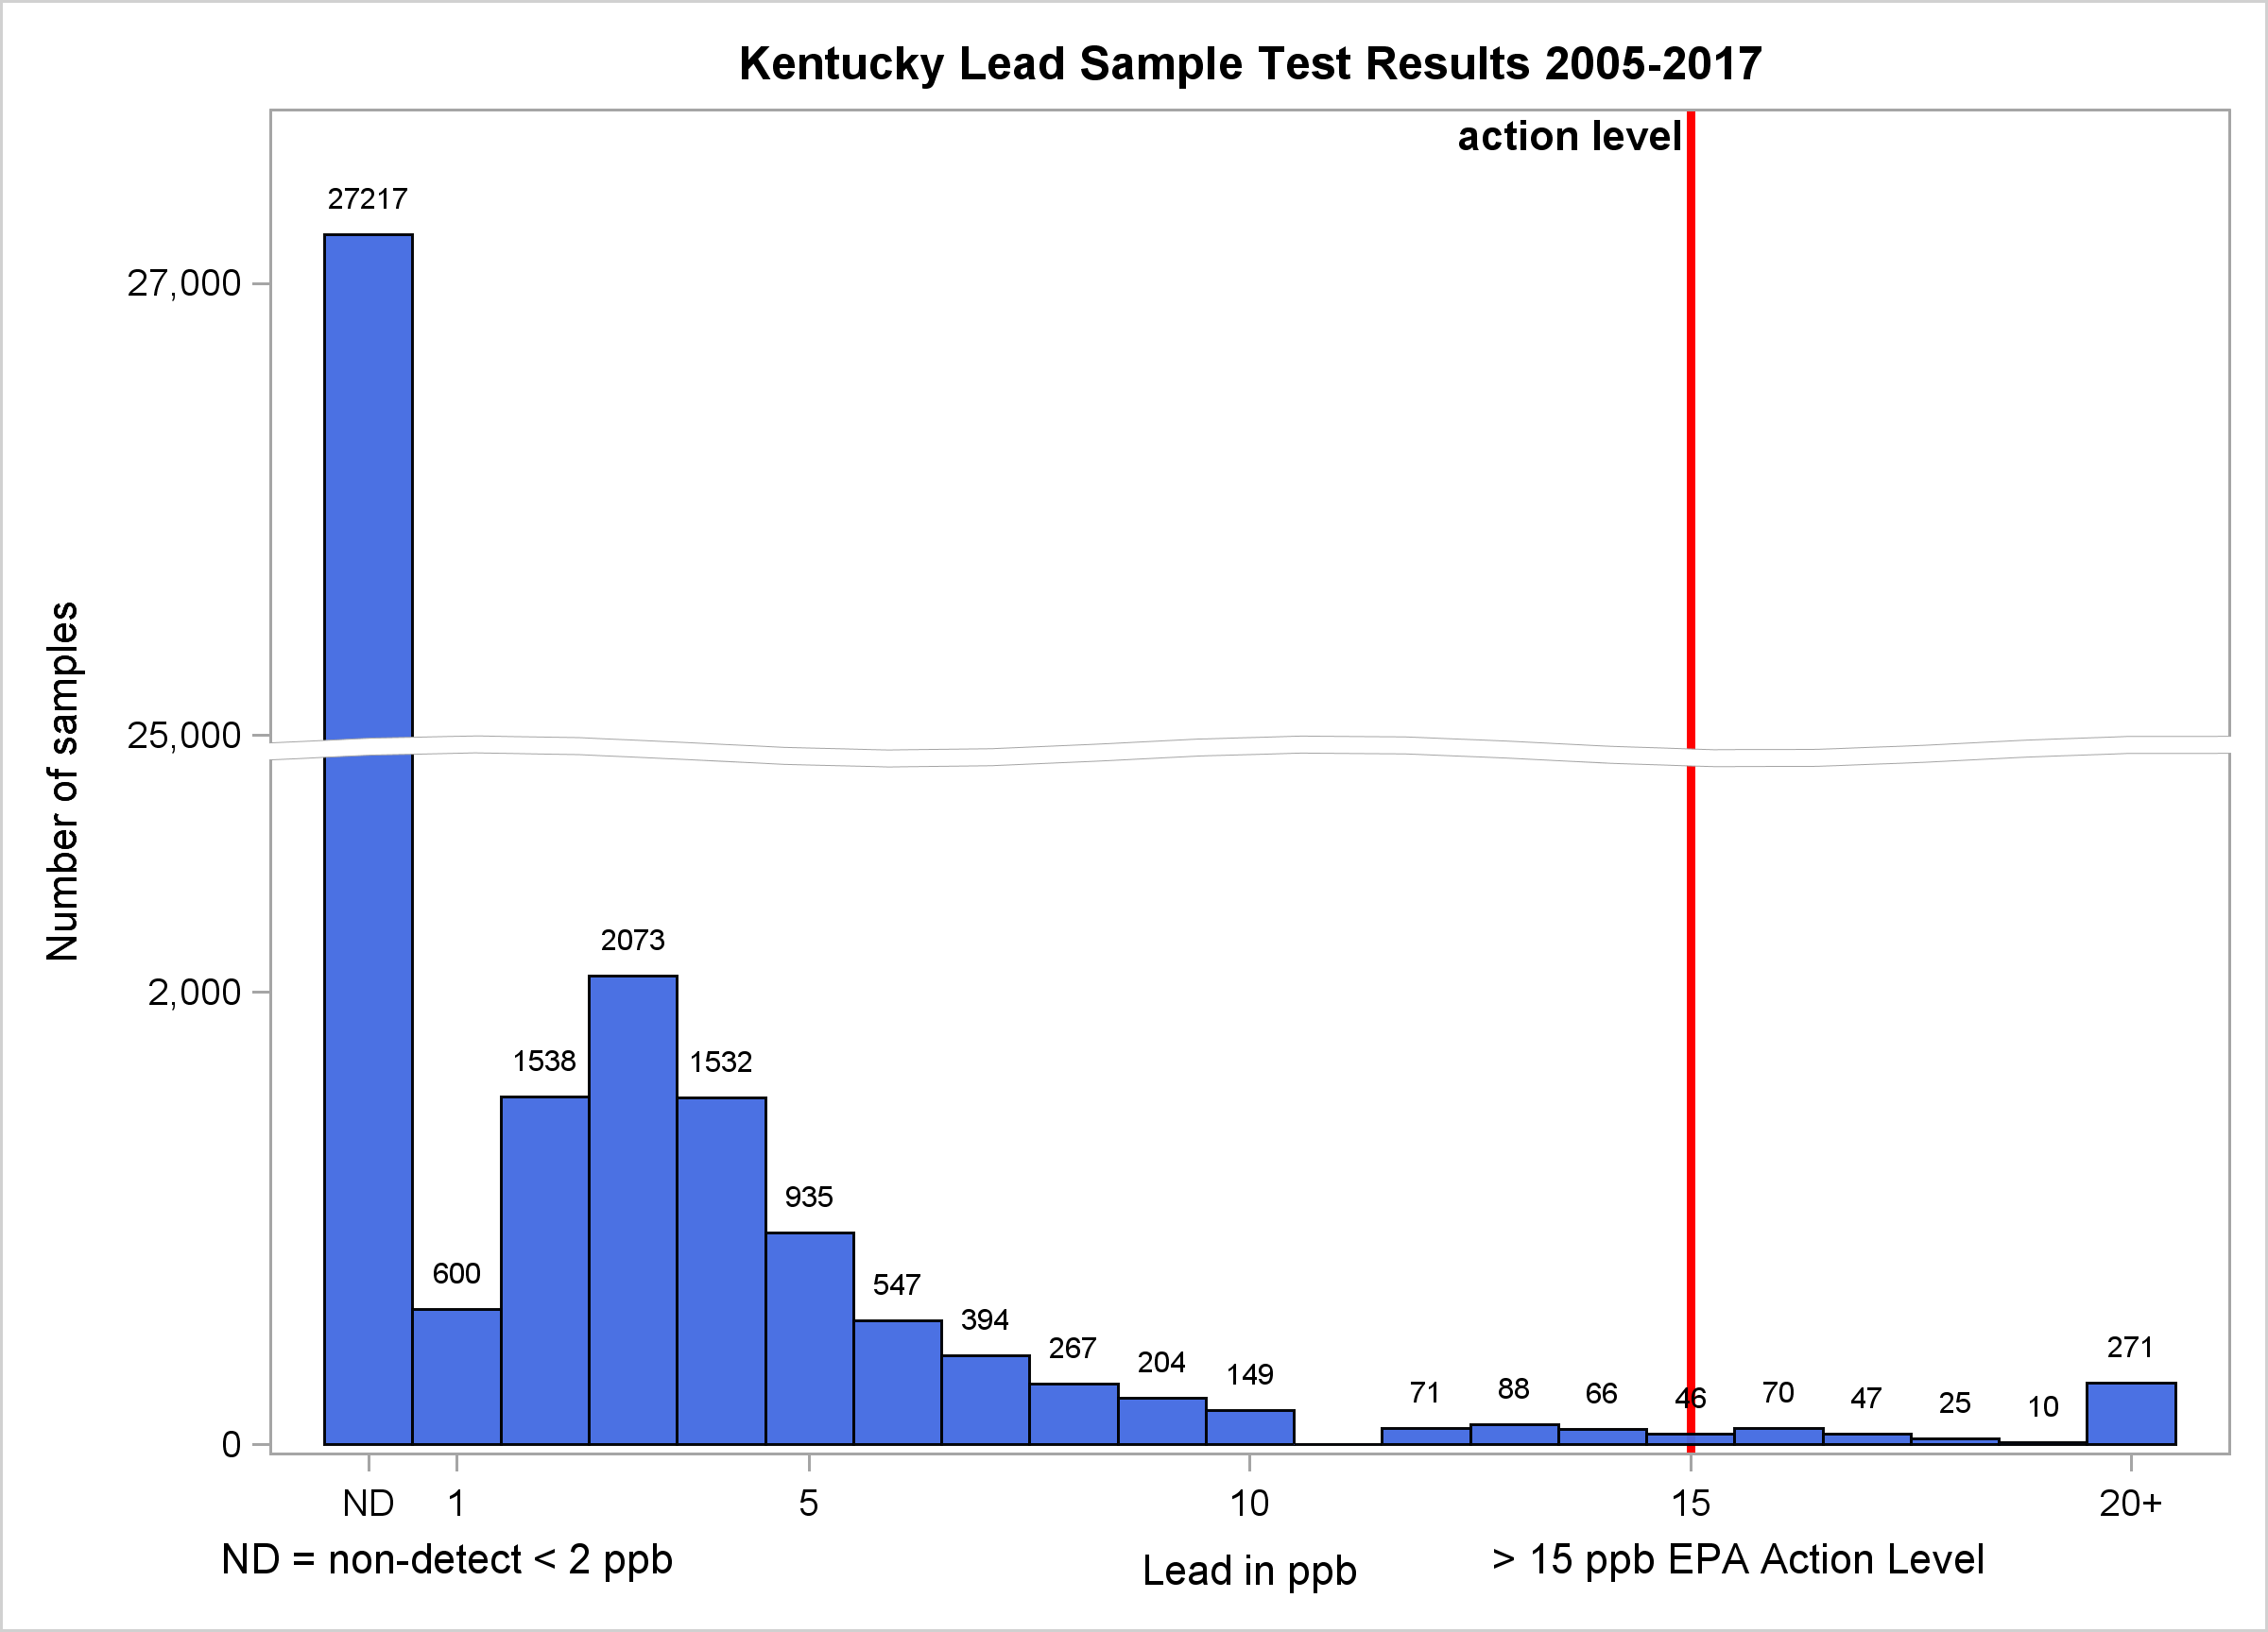

Slide 10
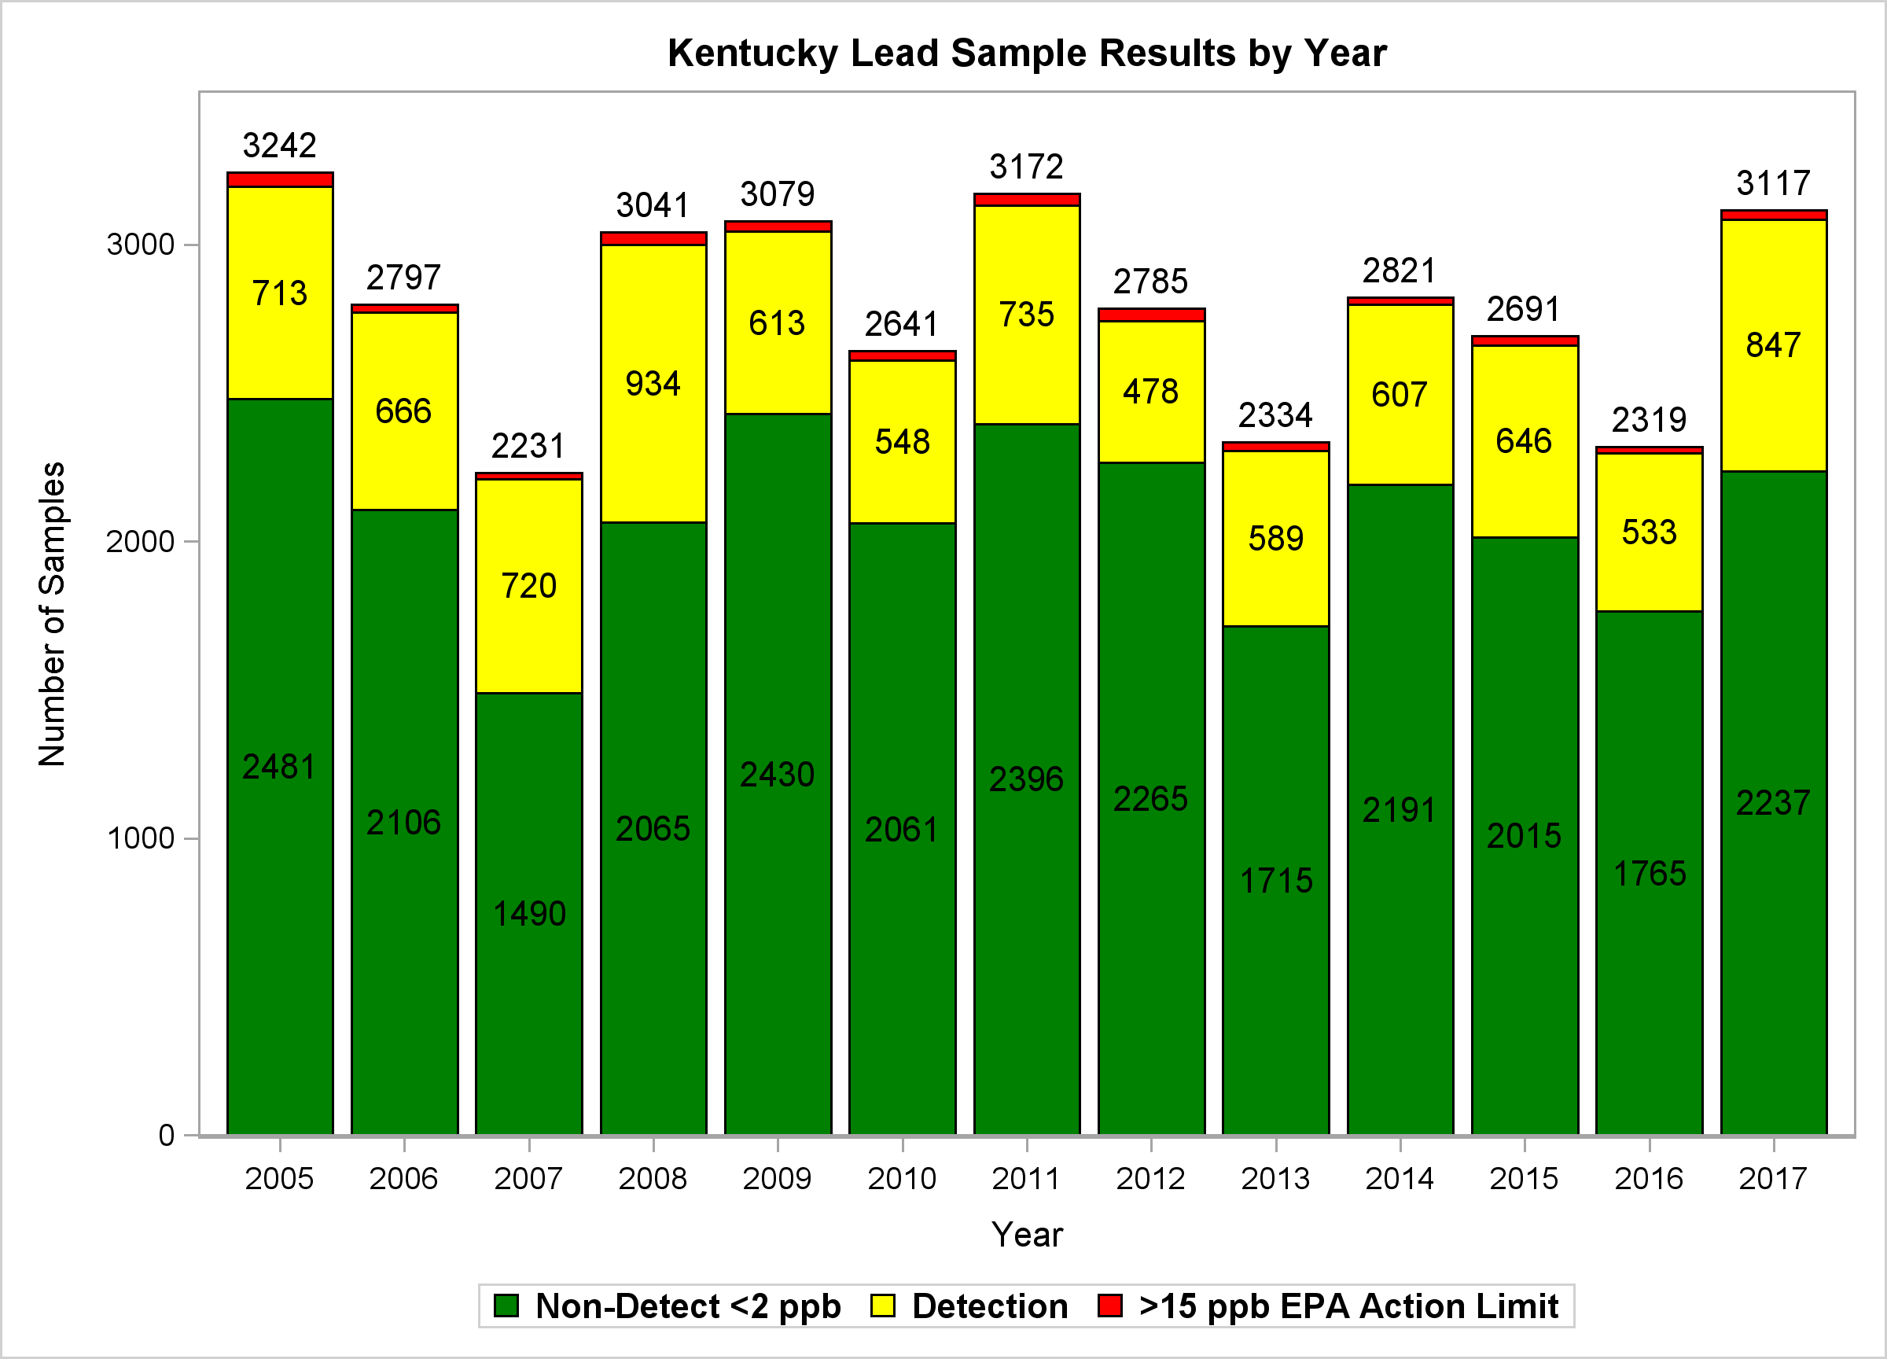

Slide 11
US Lead Service Line Inventory
What Have We Learned?
• AWWA/EPA estimates 6.1 million public
Lead Service Lines (LSL) in U.S. (range of
5.5 to 7.1 million LSL)
• Includes full and partial LSL (public and private)
• Largest density is with systems serving 10,000
to 50,000 Population.
• Generally utilities transitioned from lead to
copper between 1930 and 1960
• National cost estimate of $18 to $30 billion for 6.1 million LSL,
assumes $3,000 to $5,000 per LSL replacement costs

Slide 12
Kentucky Lead Service Line Inventory
What Have We Learned?
AWWA/EPA estimate 53,000 Public
LSL in Kentucky (we think overestimated)
Replacement Cost Range of $1,500 to $3,000 each
Estimate of $79.5 to $159 million for public portion
Estimate 13,000 Private LSL in Kentucky
Replacement Cost Range of $1,000 to $2,000
Estimate of $19.5 to $26 million for private portion
Total Kentucky Estimate for removal of Public and Private LSL
of $92.5 to $185 million (based on AWWA/EPA estimated #s)

Slide 13
How does Kentucky Compare?
United States Survey Data:
– US 2015 Population 320 million people
– 293 million people served by Community Water Systems (92% served)
– 97.7 million household connections (assumes 3 people per connection)
– 6.1 million Lead Service Lines (AWWA Journal Article June 2016)
– Estimate 6.2% of US Houses have full or partial Lead Service Lines
Kentucky Survey Data:
– Kentucky 2015 Population of 4.4 million
– 4.2 million people served by Community Water System (95%+ served)
– 1.4 million household connections (assumes 3 people per connection)
– 53,000 Lead Service Lines (AWWA Journal Article June 2016)
– Estimate 3.8% of KY Houses have full or partial Lead Service Lines
Kentucky Compares Favorably to National Average

Slide 14
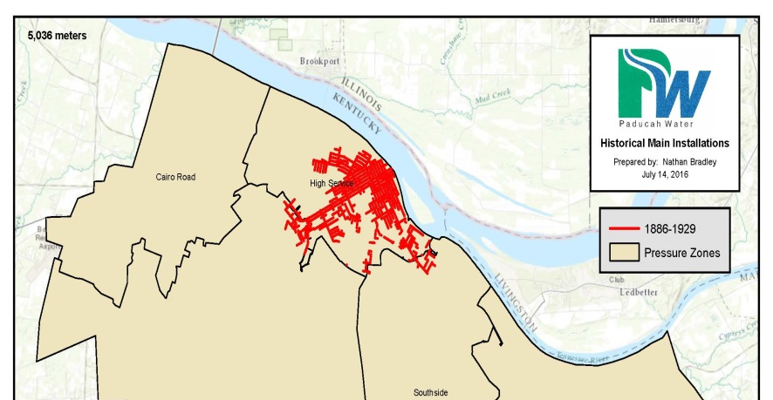
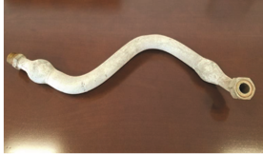
Best Practices Emerging
On-line lead service GIS database
Free water sampling for lead
Proactive lead replacement programs (public and private)
Lead replacement subsidy or finance program for homeowner’s portion of lead piping

Slide 15
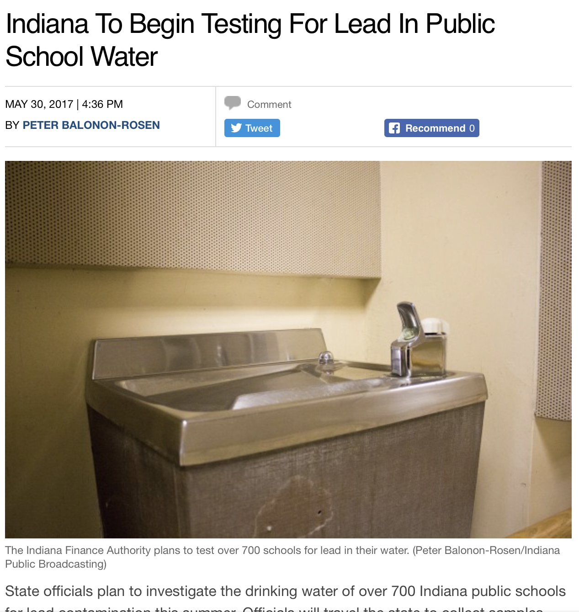
Best Practices Emerging
Optimized water treatment for corrosion
Best practices for sampling and monitoring
School partnerships for lead inventory, testing, flushing and plumbing fixture replacement (Indiana Finance Authority school program)

Slide 16
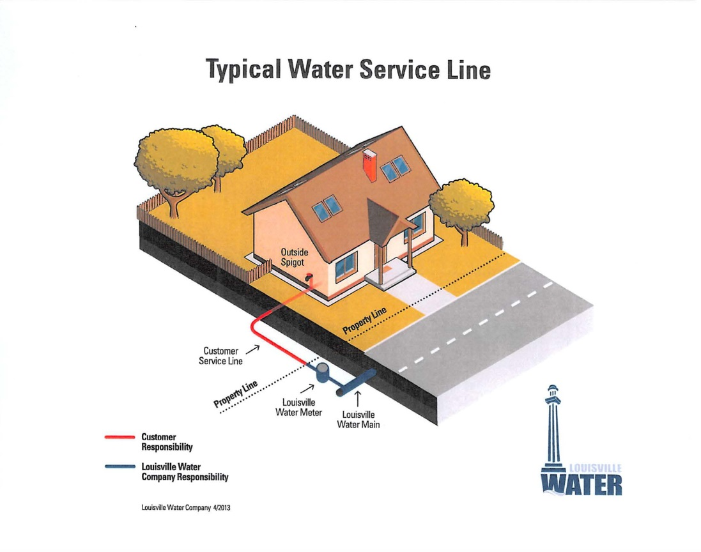
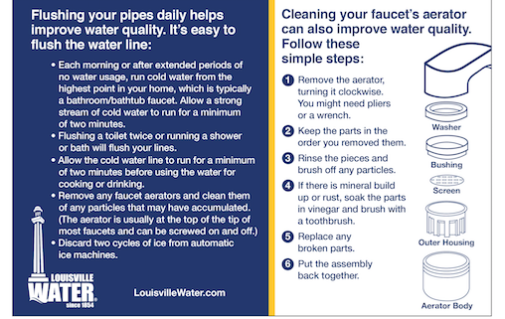
Best Practices Emerging
Lead education and communication materials
Best Practices for Flushing

Slide 17

Regulatory Possibilities
Reduction in Action Level below 10 ppb
Possibly a MCL for Lead or a Household Action Level
Change in sampling methods (cycles, size, frequency, locations)
Strict water sampling protocol for lead
Mandatory replacement programs (XX % per year)
Mandatory lead education materials provided to for consumers, including health risk info.
Private lead line replacement requirements for homeowners
Specific lead action steps for schools, daycares and public facilities

Slide 18
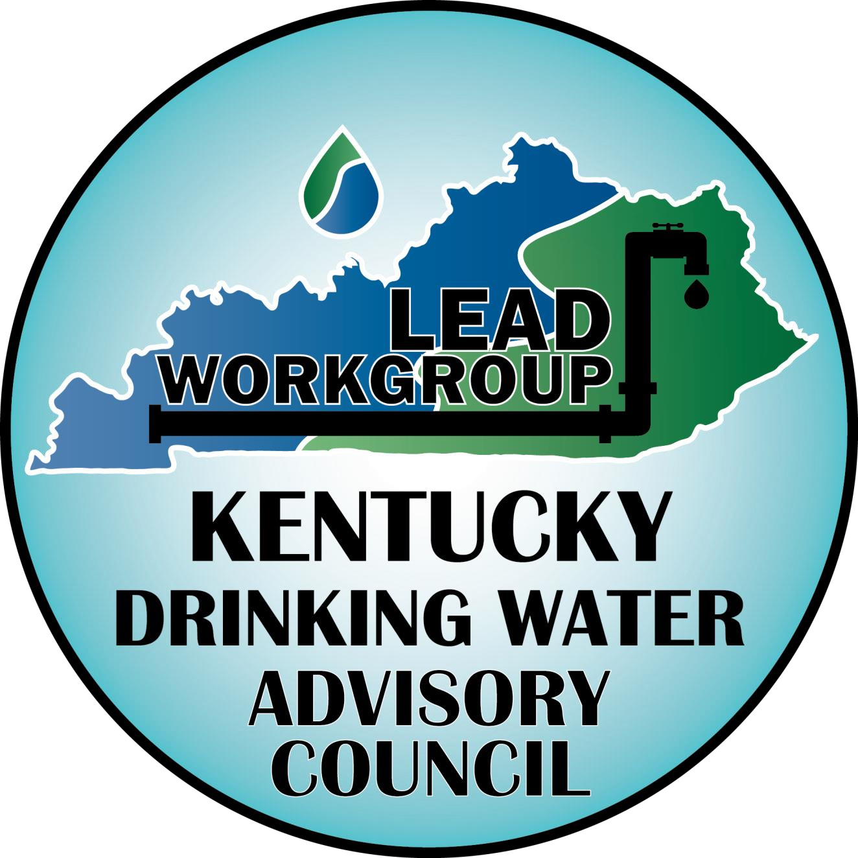
Peter Goodmann
Director
Kentucky Division of Water
peter.goodmann@ky.gov

